Slide 1
Deepfake Video Detection
Using CNN and XAI
Masters in Human Centred AI 2025-2026
Christy Maria Joseph, Neetha Mariam Sam, Praveen Sivakumar, Vibhooshan Gunasekaran

Slide 2
Introduction
What are Deepfakes?
- AI-generated videos/images that looks real but entirely fake.
Positive uses: entertainment, education, digital art
Risks: misinformation, fraud, identity theft, propaganda
Challenge: modern deepfakes are harder to detect than ever
Goal: build an accurate and explainable deepfake detection system

Slide 3
Research Objectives
Build an interpretable deep learning system to detect deepfake videos.
Focus on CNN + LSTM hybrid architecture for spatial + temporal analysis, With XAI
Evaluate against EU AI Act & GDPR for compliance.
Research Questions:
1. How effectively can a CNN+LSTM architecture distinguish real from deepfake images?
2. Which XAI techniques , feature coefficients best reveal the spatial features driving the model’s decisions?
3. To what extent do these explanations satisfy EU AI Act transparency obligations and GDPR auditability standards?

Slide 4
Literature Review-CNNs & Transformers
CNN architectures such as ResNet, VGG, Inception, and Xception achieve strong performance in detecting fake faces, with F1-scores ranging from 0.8 to 0.9.
Ensemble methods that combine a GAN, a CNN, and a memory system have reached 98.7% accuracy and remain stable against new types of deepfakes.
Hybrid approaches are becoming common, where CNNs capture local textures and transformers capture global inconsistencies across the image.
New datasets like DF40 include 40 deepfake generation methods, helping researchers evaluate models on diverse and challenging examples.

Slide 5
Literature Review-Explainable AI & Emerging Tools
Because CNNs act as black boxes, XAI methods such as Grad-CAM, LIME, and SHAP provide insights by showing which image regions influence decisions.
Network dissection techniques map neurons to specific facial parts, making the model’s reasoning more transparent.
The DF-P2E framework adds a plain-language explanation layer by combining Grad-CAM, image captioning, and large language models.
Continual learning approaches use GAN-based replay to prevent detectors from forgetting older deepfake types.
Transformer-based models such as DeiT, CLIP, and ViT improve generalization across datasets, while user studies ensure explanations are accessible and practical.

Slide 6
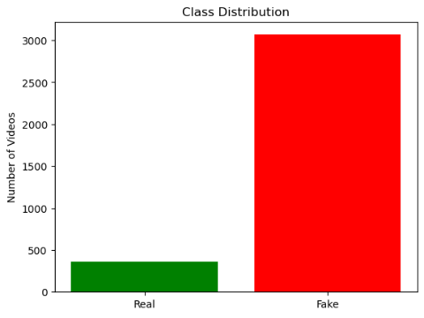
Dataset Overview
Source: Deep Fake Detection (DFD) dataset from Kaggle.
Original Sequences: 364 authentic videos.
  28 actors performing in 16 unique scenes.
Manipulated Sequences: 3,068 fake videos.
  Generated using face-swapping techniques.
Size: ~22.5 GB of video data.
Observations:
Strong class imbalance → fake videos far outnumber real ones.
Video lengths: Mostly 400–1000 frames, some >1500 frames.
Resolution: 1920×1080 (HD) → too large for deep learning training without resizing

Slide 7
Preprocessing
Frame Extraction:
Each video reduced to 10 evenly spaced frames.
Balanced dataset selection (300 real + 300 fake videos).
3,000 frames per class (6,000 total).
Resizing & Color Conversion:
Frames resized from 1920×1080 → 128×128 pixels (computationally efficient).
Converted from OpenCV BGR → RGB.
Labels:
Real = 0, Fake = 1.
Splits:
Training (70%), Validation (15%), Test (15%).

Slide 8
Baseline Model – CNN+LSTM
Detect deepfakes by combining spatial (CNN) and temporal (LSTM) features.
Input: 10 frames per video (128×128, RGB).
CNN layers (spatial features):
  3 Conv2D blocks (32 → 64 → 128 filters).
  Each block: Conv2D → BatchNorm → MaxPooling → Dropout.
  Extracts edges, textures, facial details.
Global Average Pooling: Compresses feature maps → compact vector.
LSTM layers (temporal features):
  LSTM(256 → 128 units) with Dropout.
  Captures sequential patterns between frames.
Dense Output: Sigmoid activation → Binary classification (Real vs Fake).
Training Setup:
  Optimizer: Adam (lr = 1e-4).
  Loss: Binary Cross-Entropy.
  Epochs: 20, Batch size: 8.
  EarlyStopping + ModelCheckpoint used.

Slide 9
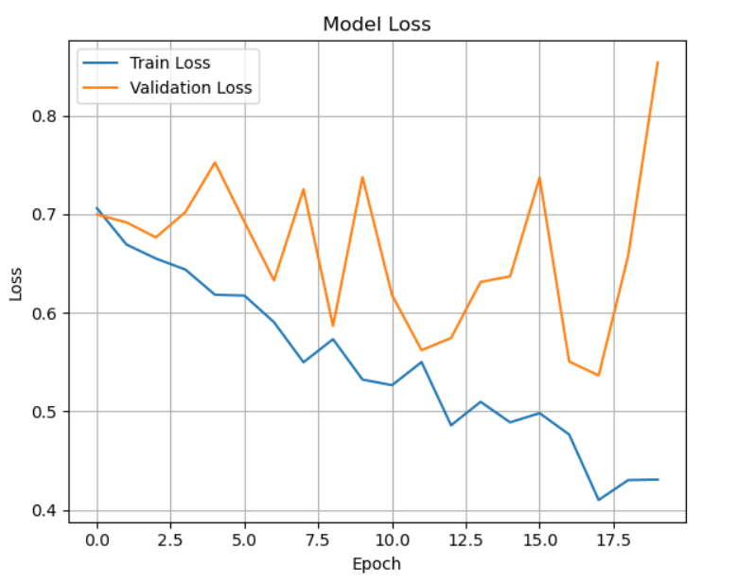
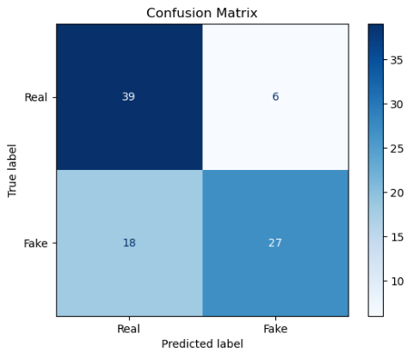
Baseline Model – CNN+LSTM
Results:
  Accuracy: 73%.
  Good on Real videos → Recall: 87%.
  Weak on Fake videos → Recall: 60%.
  Validation accuracy unstable → overfitting detected.

Slide 10
Transfer Learning Model – MobileNetV2 + LSTM
Why MobileNetV2?
Pretrained on ImageNet → strong general feature extraction.
Lightweight & efficient compared to larger CNNs.
Architecture:
MobileNetV2 backbone wrapped in TimeDistributed → frame-wise extraction.
Global Average Pooling → Compact embeddings.
LSTM (256 → 128 units) for sequential dynamics.
Dense (sigmoid) for binary classification.
Training Setup:
Epochs: 30 (with EarlyStopping).
Batch size: 8 (video memory constraint).
Saved best weights.

Slide 11
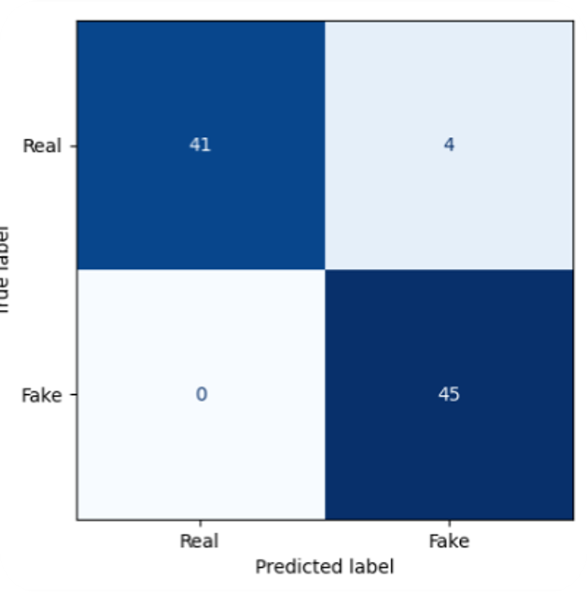
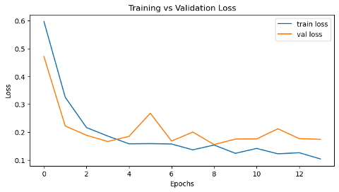
Transfer Learning Model – MobileNetV2 + LSTM
Results:
Accuracy: 96%
Excellent on Fake videos → Recall: 100%
Strong on Real videos → Recall: 91%
Training & validation curves aligned → no overfitting

Slide 12
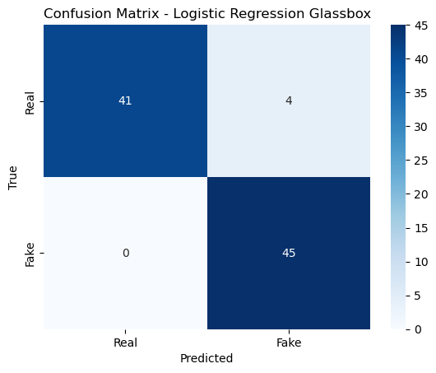
Glassbox Model – Logistic Regression
Deep learning models (CNN–LSTM) = “Black Box”, Need transparent, interpretable models
Glassbox models provide: Feature interpretability, Simpler decision boundaries, Human-understandable explanations
Method:
Use MobileNetV2 (pretrained) to extract spatial features (Global Avg Pooling).
Train a Logistic Regression classifier on extracted vectors.
Results:
Accuracy: 96% (equal to MobileNetV2 + LSTM).
Balanced precision and recall for both real and fake classes.
Interpretability: Top coefficients reveal most influential frame features
high interpretability → ideal for explainability and compliance.

Slide 13
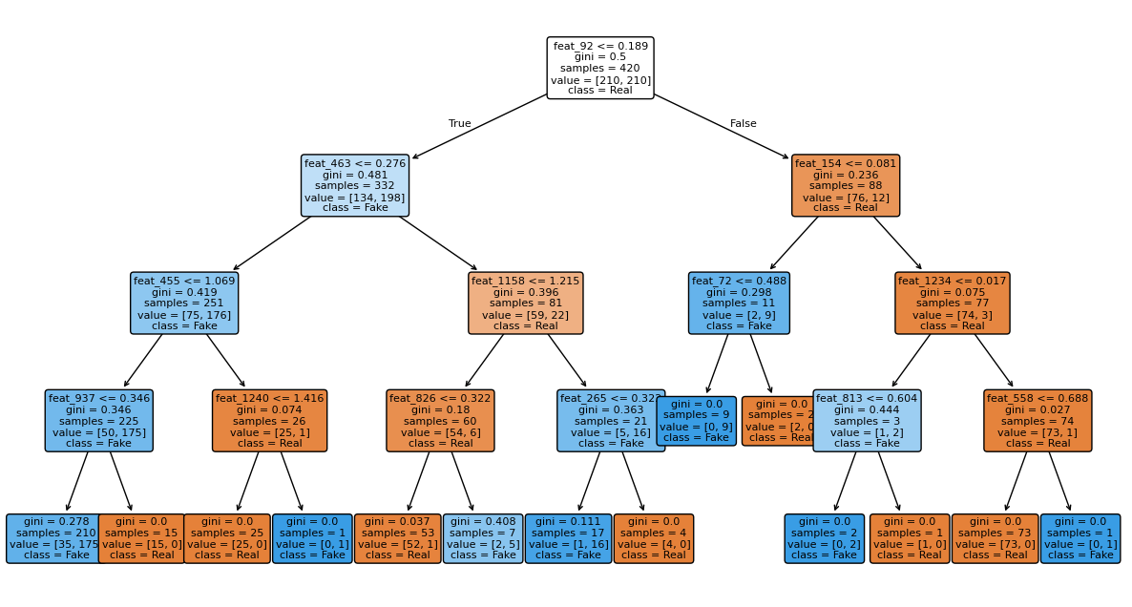
Glassbox Model – Decision Tree
Method:
Use MobileNetV2 (pretrained) to extract spatial features.
Results:
Accuracy: 82%
Better recall for Fake class (0.96) but lower for Real
Transparent: coefficients show which features contribute most.
Interpretability: Rules highlight feature thresholds → easier human understanding

Slide 14
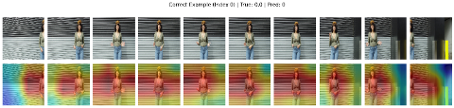

Explainable AI
Explainable AI – Grad-CAM and Saliency
Why explainability matters: Deep models are powerful but opaque; we need to verify what they “see.”
Grad-CAM heatmaps: When predictions are correct, focus is on the face and lips; when wrong, attention drifts to irrelevant background regions.
Saliency maps: Confirm the same pattern at pixel level strong activations on facial features when correct, scattered signals when confused.
Practical benefit: Shows the model relies on real visual cues, not shortcuts or artifacts.
Regulatory link: These visualizations provide transparency required by GDPR and the EU AI Act.
Grad-CAM++ of fake images
Saliency Map of fake images

Slide 15
Coefficients – Logistic Regression
In Logistic Regression, the model learns weights (coefficients) for each input feature.
These coefficients represent how strongly each feature contributes to predicting real vs fake.
  Positive coefficient → pushes prediction towards "Fake"
  Negative coefficient → pushes prediction towards "Real"
Why Coefficients are Explainable?
  Transparent and easy to interpret → Glass-box model
  Stakeholders can see which features drive predictions
  Supports accountability & trust in AI systems

Slide 16
Coefficients – Logistic Regression
Application in our Project
  We used MobileNetV2 as a feature extractor (turning video frames into numerical feature vectors).
  Then Logistic Regression assigned coefficients to these features.
  By analyzing these coefficients, you can trace back which features had the biggest influence in deciding if a video is fake or real.
Complications
  Unfortunately, feat_1, feat_2, etc. do not directly map to a human-understandable attribute like "eye" or "mouth".
  Tools like Activation Maximization or DeepDream show what kind of pattern activates a neuron/feature.
  Another option is going for other XAI methods.

Slide 17
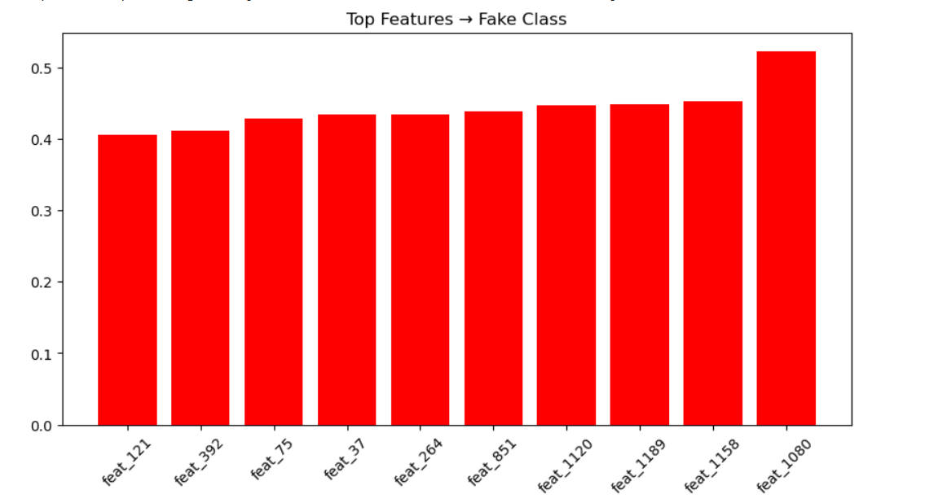
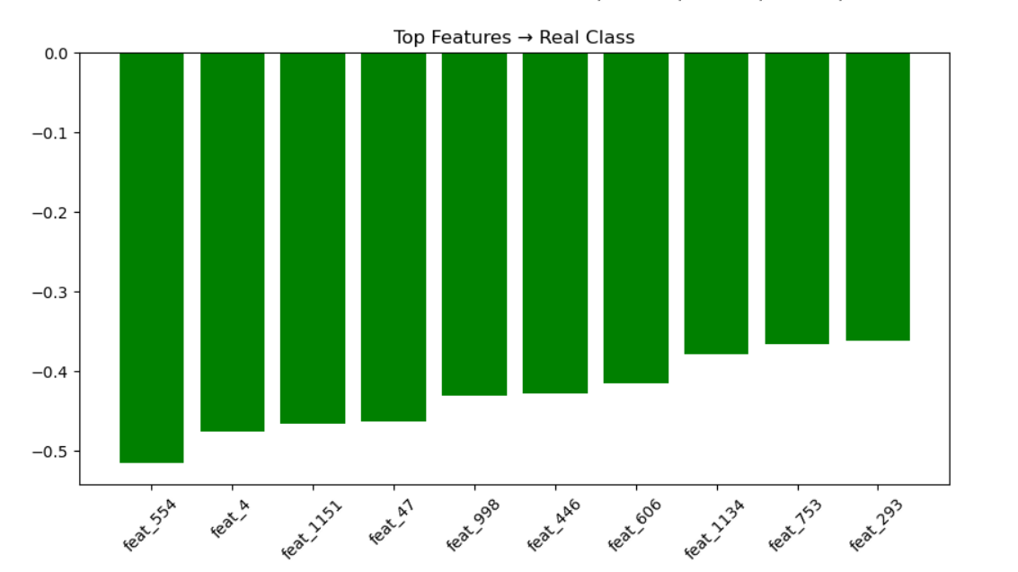
Coefficients – Logistic regression

Slide 18
Best Model Comparison
Baseline Model – CNN + LSTM
  Accuracy: 73%
  Strengths:
    Simple architecture, combines spatial & temporal info
  Weaknesses:
    Overfitting → poor generalization
    Low recall for fake videos (60%) → missed many deepfakes
  Takeaway: Not robust enough for subtle manipulations
Transfer Learning – MobileNetV2 + LSTM
  Accuracy: 96%
  Strengths:
  Leverages ImageNet pretraining → strong spatial features
  Balanced performance: Real (91% recall), Fake (100% recall)
  Generalizes well, no major overfitting
  Weaknesses:
  Computationally heavier than baseline

Slide 19
Best Model Comparison
Glass-box – Logistic Regression (with MobileNetV2 features)
  Accuracy: 96% (same as MobileNetV2 + LSTM)
  Strengths:
  Fully interpretable (coefficients explain feature importance)
  Simple, lightweight, transparent → regulator-friendly
  Weaknesses:
  Cannot capture temporal dynamics between frames
Glass-box – Decision Tree (with MobileNetV2 features)
  Accuracy: 82%
  Strengths:
  Rule-based, human-readable decisions
  Excellent recall for fake videos (96%)
  Weaknesses:
  Lower overall accuracy
  Complex trees with high-dimensional features reduce interpretability
Comparing all the models and the level of interpretability, we concluded that MobileNetV2 + LSTM is the best model.

Slide 20
Compliance
GDPR Compliance
  Data from public, research-approved sources
  Metadata is removed so no hidden personal details remain.
  Explainable AI tools (Grad-CAM++, Saliency Maps) show why a video was flagged , supports the GDPR “right to explanation.”
EU AI Act Compliance
  The system is transparent, showing visual evidence of how it made decisions.
  The model is tested for accuracy and reliability, using proven methods like transfer learning and stress tests.
  Every step (datasets, model design, and results) is fully documented, so regulators and researchers can review it
UN Sustainable Development Goals (SDGs)
  SDG 9 – Innovation and Infrastructure:
  We build advanced but responsible AI that is transparent and trustworthy.
  SDG 16 – Peace and Justice:
  Detecting deepfakes helps fight misinformation, fraud, and identity theft, protecting democracy and social trust.

Slide 21
Conclusion & Future Work
Key Findings:
  Baseline CNN+LSTM struggled (73% accuracy).
  Transfer learning (MobileNetV2+LSTM) achieved 96% accuracy with balanced performance.
  Logistic Regression offered equal accuracy + interpretability.
  Grad-CAM provided transparency for compliance & trust.
Future Work:
  Extend to multimodal detection (audio + video).
  Improve adversarial robustness against evolving deepfake methods.
  Explore more advanced XAI tools beyond Grad-CAM.
  Optimize models for real-world deployment (social media, forensics).

Slide 22
Thank You!

